Slide 1
WEEKLY ASSESMENT FOR October 12-18, 2026
Projects, Program and Activities` |  | ANTI-CARNAPPING OPERATIONS (70 points) |  |  |  |  |  |  |  |  |  |  | ENFORCEMENT OF TRAFFIC LAWS (20 points) |  |  |  | DHPG PROGRAM THRUST (10 points) |  |  |  |  | TOTAL
 |  | NUMBER OF ARRESTED PERSON INVOLVED IN CARNAPPING |  | NUMBER OF ARMED ENCOUNTER IN CARNAPPING (HPG Initiated Only) | NUMBER OF RECOVERED/ CONFISCATED FIREARMS (HPG Initiated Only) | NUM BER OF CARNAPPING CASES FILED IN COURT (HPG Initiated Only) | NUMBER OF RECOVERED VEHICLES |  |  |  |  |  | NUMBER OF IMPOUNDED VEHICLES (HPG Initiated Only) |  | NUMBER OF HPG ISSUANCES |  | CONFISCATED ITEMS IN VIOLATION OF PD 96 |  | CASE FILED Article 177 “Usurpation of authority (RA 3185)/Prohibiting, among others, the wearing, use.... (EO 297)/Illegal use of uniform or insignia (PD 38, Article 179) | CONFISCATION/ REMOVAL (HPG Seal/Logo/Rider Badges)
 |  |  |  |  |  |  | VIMS |  | CIRAS |  | OTHERS (Flash Alarmed, schemes/ modus involving MV/MC)
 |  | With WOA | W/O WOA | DIPO |  |  |  |  |  |  |  |  |  |  |  |  |  |  |  | MV | MC
 |  |  |  |  |  |  | MV | MC | MV | MC | MV | MC | MV | MC | TOPs | OVRs/ TCTs | MV | MC
Allocated Points |  | 10 | 2 | 10 | 5 | 5 | 10 | 7 | 10 | 7 | 3 | 1 | 9 | 6 | 3 | 2 | 3 | 2 | 2 | 2 | 1 | 100
PHPT | North Cotabato
 | Sultan Kudarat
 | South Cotabato
 | General Santos City | 0 | 0 | 0 | 0 | 0 | 0 | 0 | 0 | 0 | 0 | 0 | 4 | 8 | 15 | 0 | 0 | 0 | 0 | 0
 | Sarangani
 | HQs/SOT
 | TOTAL

Slide 2




RHPU 12 WEEKLY ASSESSMENT
(October 12-16, 2026)

Slide 3
MOTOR VEHICLE/ MOTORCYCLE RECOVERY
IMPOUNDED
PHPT | MV | MC | TOTAL
North Cotabato
Sultan Kudarat
South Cotabato
General Santos City | 4 | 8 | 12
Sarangani
SOT
TOTAL

Slide 4
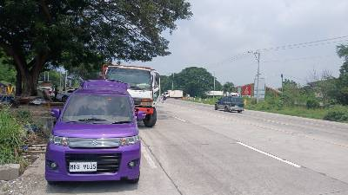
MOTOR VEHICLE RECOVERY
 | Date / Time of Operation | October 15, 2026
 | Place of Operation | NHW, General Santos City
 | Mode of Operation | AnCar, RA 4136 and Other related laws
 | Recovering unit | General Santos City HPT
 | Make/Type/Model | SUZUKI
 | Plate Number | MBG9035
 | Chassis Number | MH23S-897342
 | Motor Number | K6A-A304015
 | Color | VIOLET/BLACK
 | Violation/s | OR/CR not carried "ATTA"
 | Status | Impounded for verification
 | Driver/possessor | MANTAWIN, DHATS SALIK
 | Address | PALITAN, TUPI SOUTH COTABATO
 | Registered Owner | ESMAEL, BAI-ANN
 | Address | Labangal, General Santos City
 | Action Taken | Inform rightful owner to bring updated registration.

Slide 5
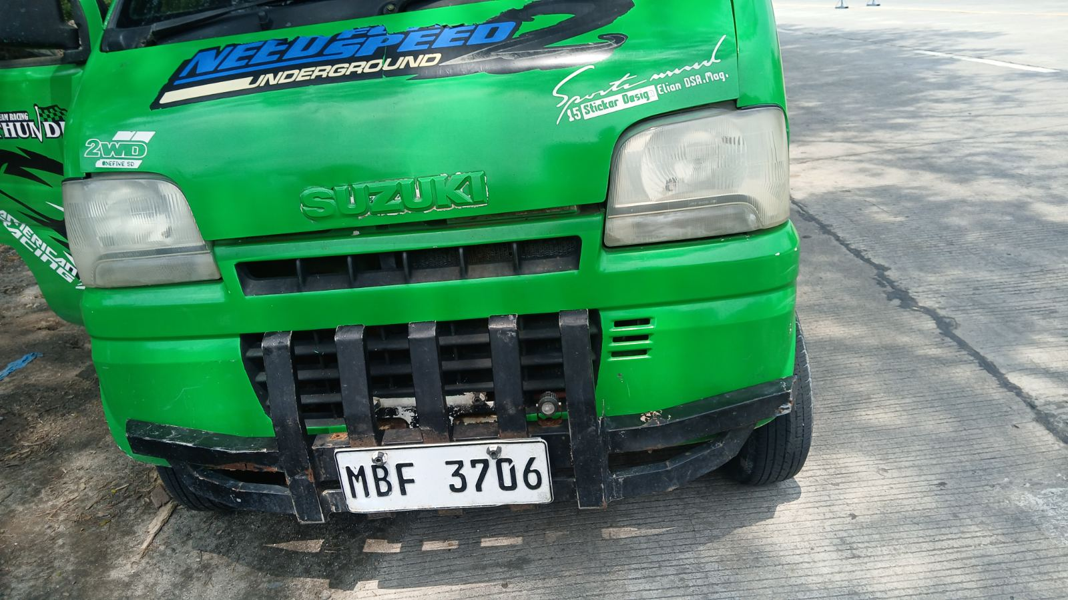
MOTOR VEHICLE RECOVERY
 | Date / Time of Operation | October 15, 2026
 | Place of Operation | NHW, General Santos City
 | Mode of Operation | AnCar, RA 4136 and Other related laws
 | Recovering unit | General Santos City HPT
 | Make/Type/Model | SUZUKI
 | Plate Number | MBF3706
 | Chassis Number | DA52T-227719
 | Motor Number | F6A-2088916
 | Color | APPLE GREEN
 | Violation/s | OR/CR not carried "ATTA"
 | Status | Impounded for verification
 | Driver/possessor | TUA, MOHAMMAD SAUDI SAMAD
 | Address | LUMATIL, MAASIM SARANGANI PROVINCE
 | Registered Owner | TUA, MOHAMMAD SAUDI SAMAD
 | Address | LUMATIL, MAASIM SARANGANI PROVINCE
 | Action Taken | Inform rightful owner to bring updated registration.

Slide 6
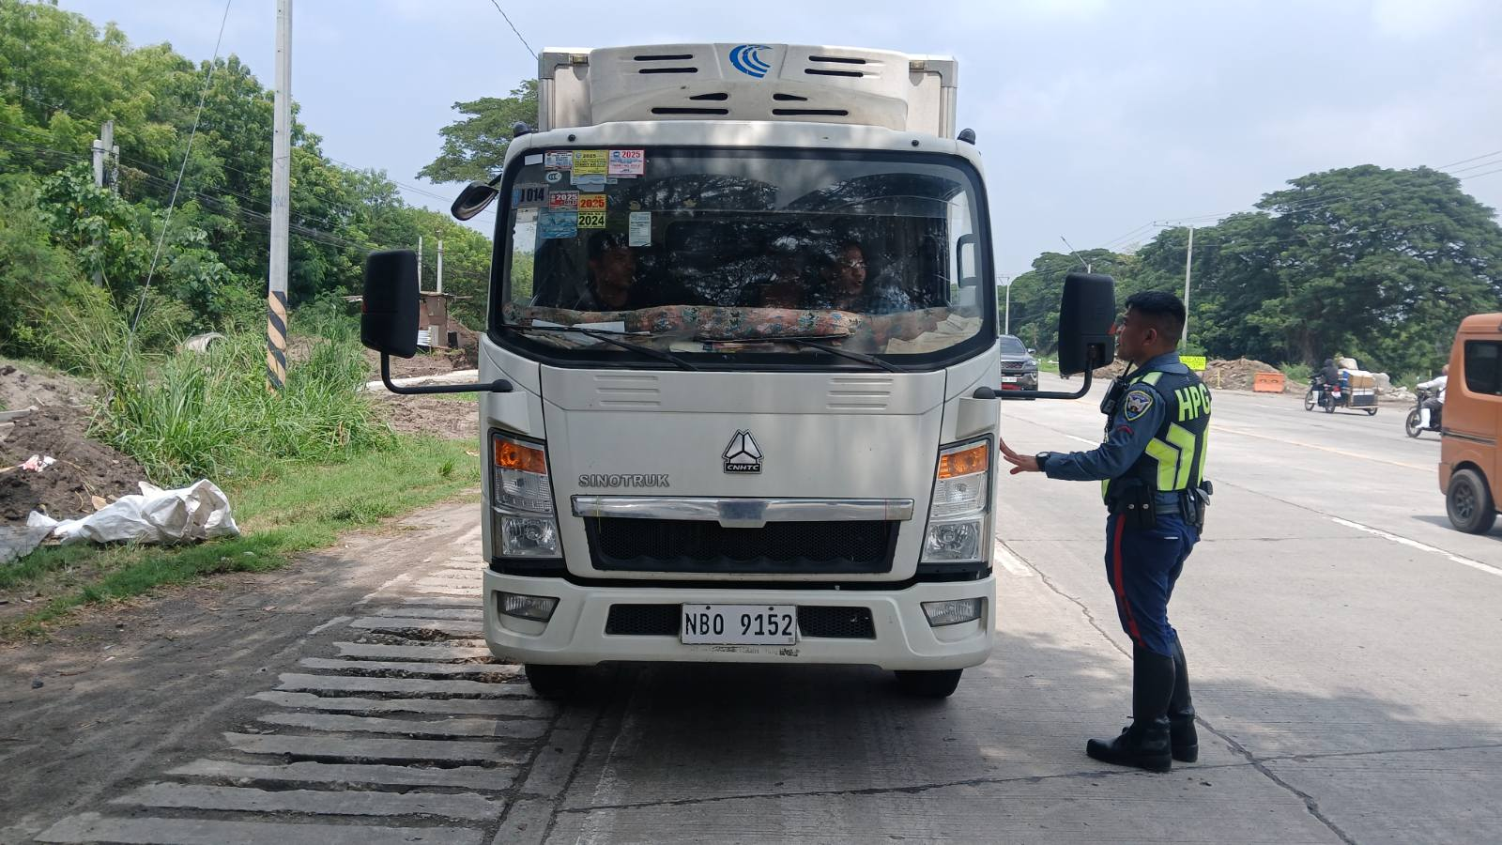
MOTOR VEHICLE RECOVERY
 | Date / Time of Operation | October 15, 2026
 | Place of Operation | NHW, General Santos City
 | Mode of Operation | AnCar, RA 4136 and Other related laws
 | Recovering unit | General Santos City HPT
 | Make/Type/Model | HOWO
 | Plate Number | NBO9152
 | Chassis Number | ***********
 | Motor Number | ***********
 | Color | WHITE
 | Violation/s | OR/CR not carried "ATTA"
 | Status | Impounded for verification
 | Driver/possessor | TOQUIB, JOHN CARL BAGOBE
 | Address | FATIMA, GENERAL SANTOS CITY
 | Registered Owner | TOQUIB, JOHN CARL BAGOBE
 | Address | FATIMA, GENERAL SANTOS CITY
 | Action Taken | Inform rightful owner to bring updated registration.

Slide 7
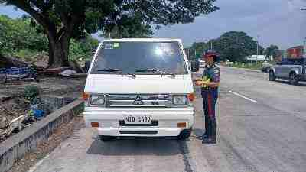
MOTOR VEHICLE RECOVERY
 | Date / Time of Operation | October 15, 2026
 | Place of Operation | NHW, General Santos City
 | Mode of Operation | AnCar, RA 4136 and Other related laws
 | Recovering unit | General Santos City HPT
 | Make/Type/Model | MITSUBISHI
 | Plate Number | NID1492
 | Chassis Number | ***********
 | Motor Number | 4N14UAL2290
 | Color | WHITE
 | Violation/s | OR/CR not carried "ATTA"
 | Status | Impounded for verification
 | Driver/possessor | ESCALIRA, SANDY GODINEZ
 | Address | SIRAWAN, TORIL, DAVAO CITY, DAVAO DEL SUR
 | Registered Owner | THFOOD INDUSTRIES INC.
 | Address | TABOK MANDAUE CITY CEBU
 | Action Taken | Inform rightful owner to bring updated registration.

Slide 8
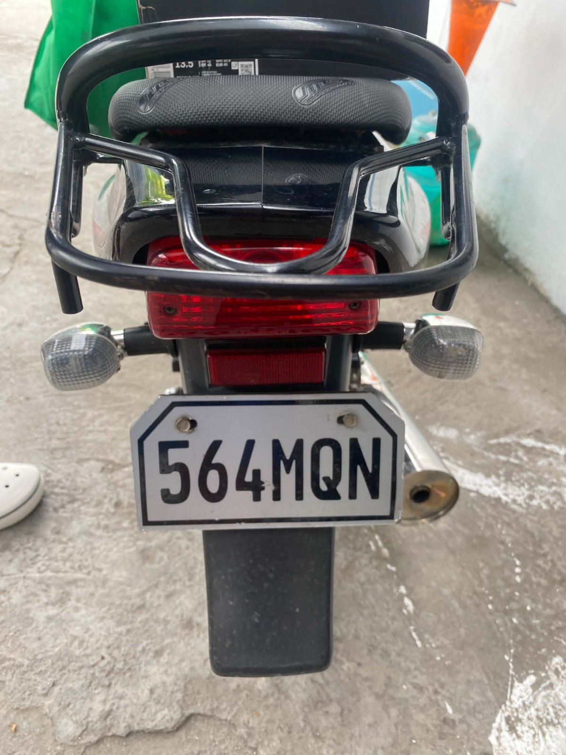
MOTORCYCLES RECOVERY
 | Date / Time of Operation | October 12, 2026
 | Place of Operation | NHW Conel, General Santos City
 | Mode of Operation | AnCar, RA 4136 and Other related laws
 | Recovering unit | General Santos City HPT
 | Make/Type/Model | KAWASAKI
 | Plate Number | 564MQN
 | Chassis Number | MC2A76311PA2A32267
 | Motor Number | DYXWMM52569
 | Color | BLACK/RED
 | Violation/s | OR/CR not carried "ATTA"
 | Status | Impounded for verification
 | Driver/possessor | CAPISTRANO VINCENT SEBAN
 | Address | DAD NORTH, GENERAL SANTOS CITY
 | Registered Owner | CAPISTRANO VINCENT SEBAN
 | Address | DAD NORTH, GENERAL SANTOS CITY
 | Action Taken | Inform rightful owner to bring updated registration.

Slide 9
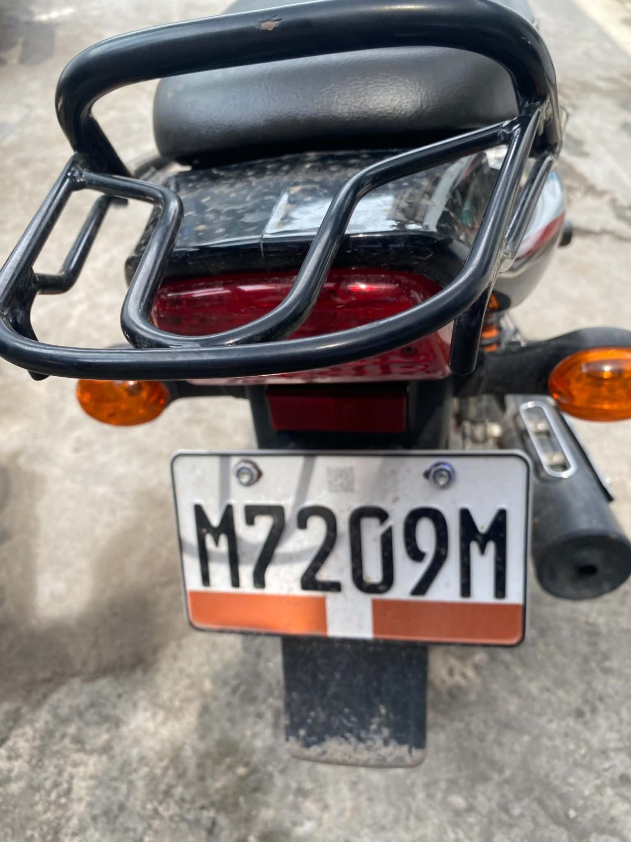
MOTORCYCLES RECOVERY
 | Date / Time of Operation | October 12, 2026
 | Place of Operation | NHW Conel, General Santos City
 | Mode of Operation | AnCar, RA 4136 and Other related laws
 | Recovering unit | General Santos City HPT
 | Make/Type/Model | KAWASAKI
 | Plate Number | M7209M
 | Chassis Number | MD2A76BX0SWH12941
 | Motor Number | DYXWSH29892
 | Color | BLACK
 | Violation/s | DRIVER LICENSE not carried "ATTA"
 | Status | Impounded for verification
 | Driver/possessor | ISLA RONIO GUNDANG
 | Address | SITIO MOTOKLING T’BOLI SOUTH COTABATO
 | Registered Owner | NETNET BANDAAN BONG
 | Address | SITIO MOTOKLING T’BOLI SOUTH COTABATO
 | Action Taken | Inform rightful owner to bring updated registration.

Slide 10
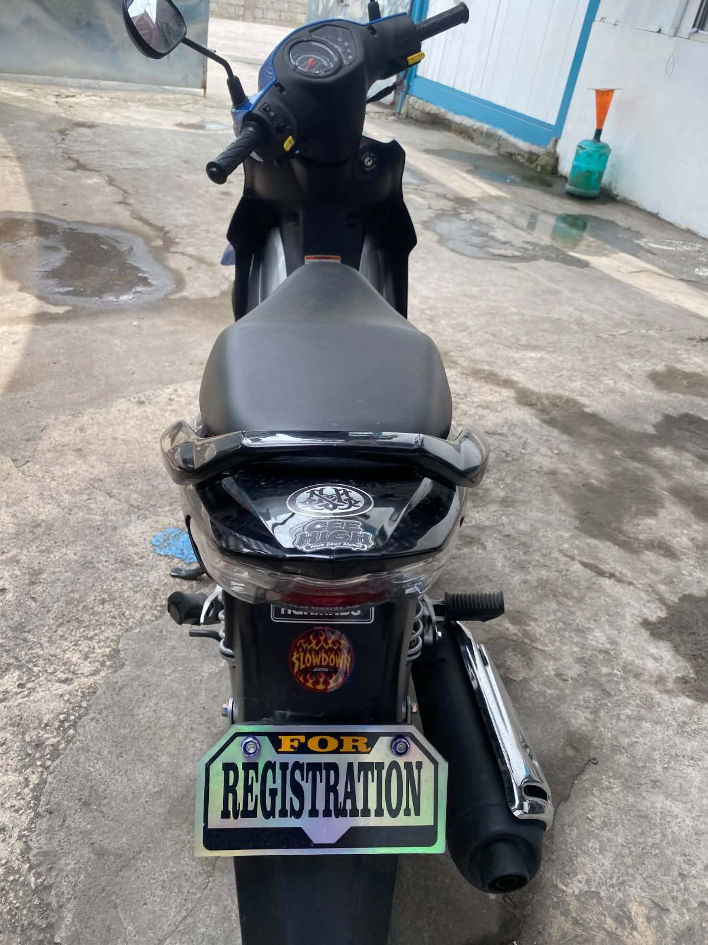
MOTORCYCLES RECOVERY
 | Date / Time of Operation | October 12, 2026
 | Place of Operation | NHW Conel, General Santos City
 | Mode of Operation | AnCar, RA 4136 and Other related laws
 | Recovering unit | General Santos City HPT
 | Make/Type/Model | HONDA
 | Plate Number | FOR REGISTRATION
 | Chassis Number | ***********
 | Motor Number | ***********
 | Color | BLACK
 | Violation/s | OR/CR not carried "ATTA"
 | Status | Impounded for verification
 | Driver/possessor | JAIME CHARLES ANDRIAN GALANG
 | Address | BRGY SAN ISIDRO GENERAL SANTOS CITY
 | Registered Owner | JAIME CHARLES ANDRIAN GALANG
 | Address | BRGY SAN ISIDRO GENERAL SANTOS CITY
 | Action Taken | Inform rightful owner to bring updated registration.

Slide 11
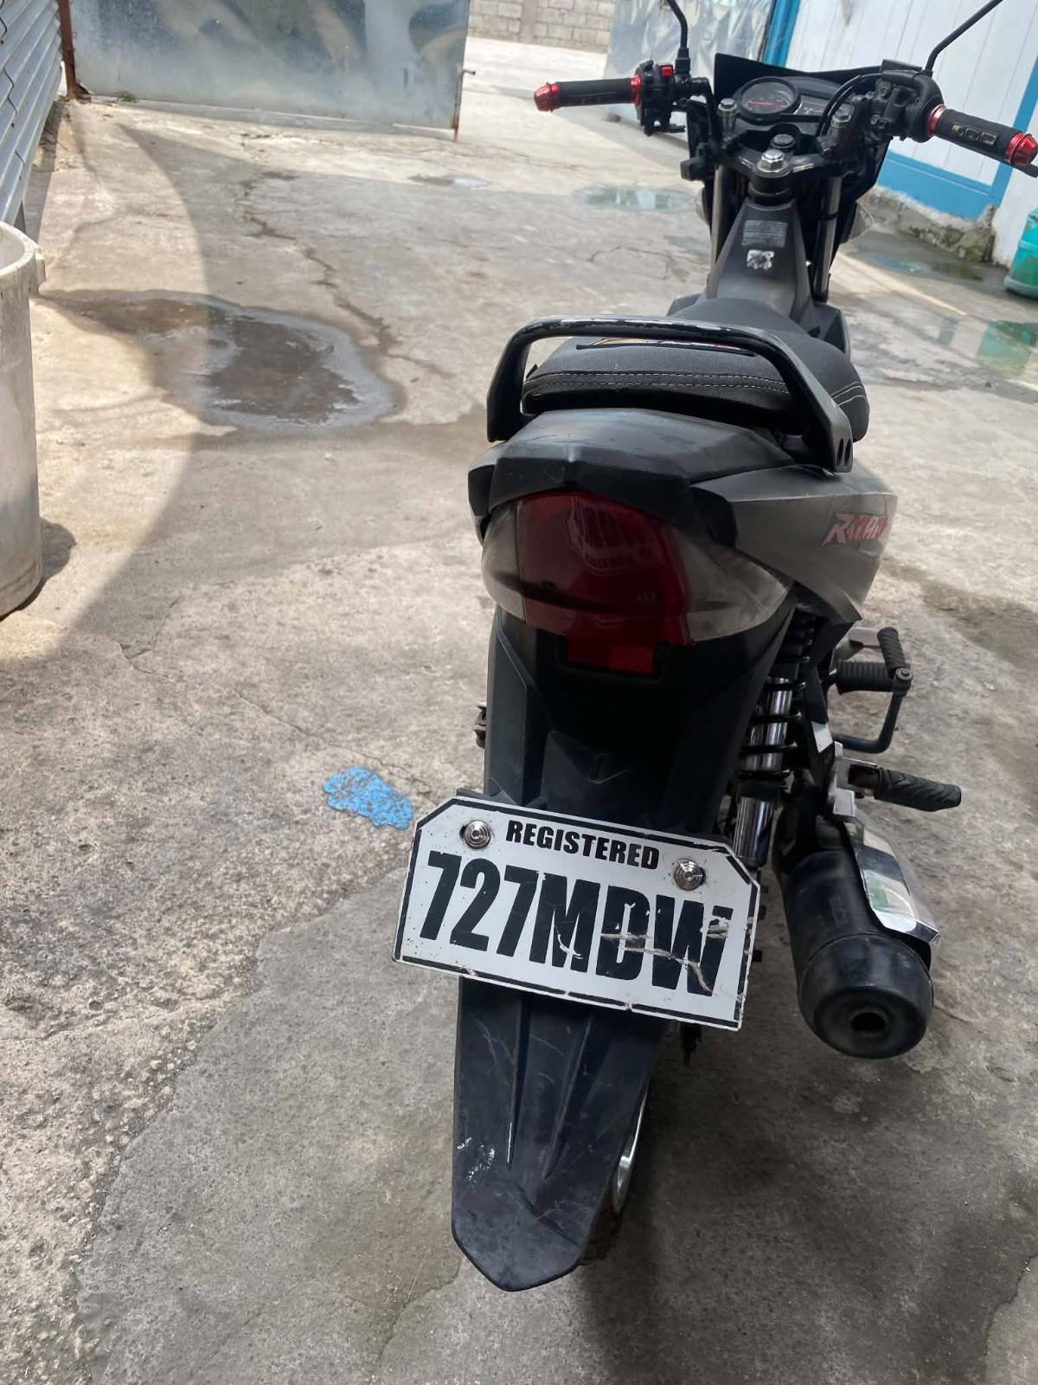
MOTORCYCLES RECOVERY
 | Date / Time of Operation | October 12, 2026
 | Place of Operation | NHW Conel, General Santos City
 | Mode of Operation | AnCar, RA 4136 and Other related laws
 | Recovering unit | General Santos City HPT
 | Make/Type/Model | HONDA
 | Plate Number | 727MDW
 | Chassis Number | KPG20062424
 | Motor Number | KPG20E062458
 | Color | BLACK
 | Violation/s | DRIVER LICENSE not carried "ATTA"
 | Status | Impounded for verification
 | Driver/possessor | VINCENT DELOY
 | Address | BRGY CALUMPANG GENERAL SANTOS CTIY
 | Registered Owner | JAYSON DIOLA MULA
 | Address | BRGY CALUMPANG GENERAL SANTOS CITY
 | Action Taken | Inform rightful owner to bring updated registration.

Slide 12
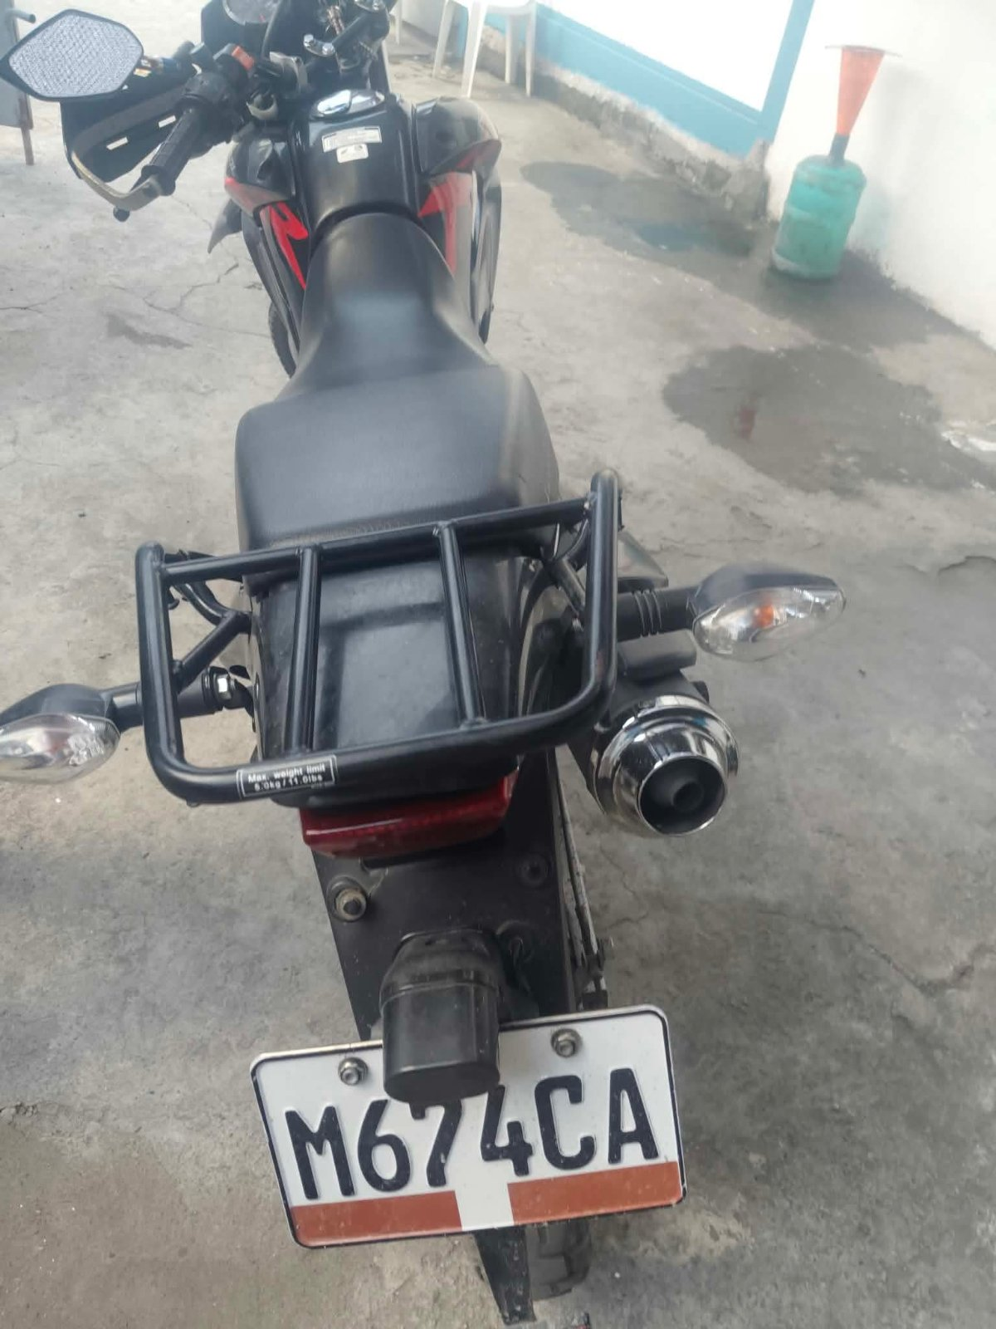
MOTORCYCLES RECOVERY
 | Date / Time of Operation | October 12, 2026
 | Place of Operation | NHW Conel, General Santos City
 | Mode of Operation | AnCar, RA 4136 and Other related laws
 | Recovering unit | General Santos City HPT
 | Make/Type/Model | HONDA
 | Plate Number | M674CA
 | Chassis Number | KRHV0068735
 | Motor Number | KRH10E062337
 | Color | BLACK
 | Violation/s | OR/CR not carried "ATTA"
 | Status | Impounded for verification
 | Driver/possessor | DALAWAN RICKY MONTIL
 | Address | LAKE SEBU SOUTH COTABATO
 | Registered Owner | KIEL LAYOL LINGGAW
 | Address | PRK CENTRO DESAWO T’BOLI SOUTH COTABATO
 | Action Taken | Inform rightful owner to bring updated registration.

Slide 13
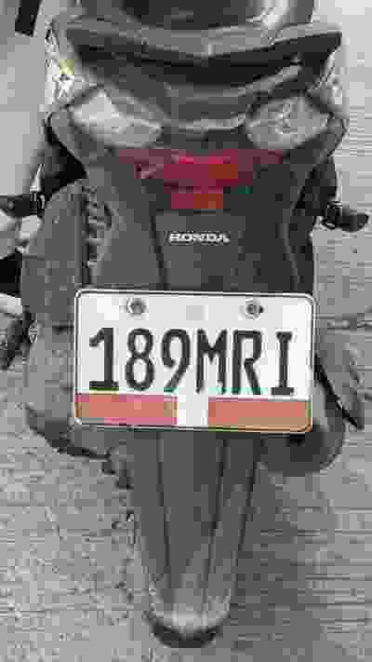
MOTORCYCLES RECOVERY
 | Date / Time of Operation | October 15, 2026
 | Place of Operation | NHW Apopong, General Santos City
 | Mode of Operation | AnCar, RA 4136 and Other related laws
 | Recovering unit | General Santos City HPT
 | Make/Type/Model | Honda
 | Plate Number | 189MRI
 | Chassis Number | K81P2014457
 | Motor Number | JF78E7423710
 | Color | BLACK
 | Violation/s | OR/CR not carried "ATTA"
 | Status | Impounded for verification
 | Driver/possessor | JALAPIT, DAVE ZECH BENDULA
 | Address | SILWAY 8, POLOMOLOK SOUTH COTABATO
 | Registered Owner | JED MEJIA JALAPIT
 | Address | SILWAY 8, POLOMOLOK SOUTH COTABATO
 | Action Taken | Inform rightful owner to bring updated registration.

Slide 14
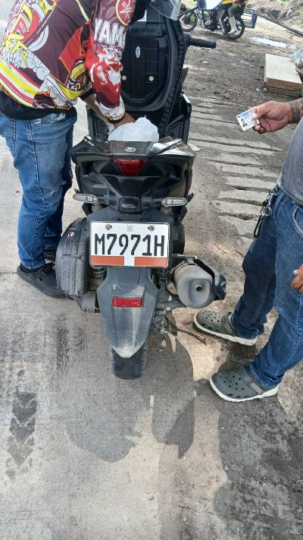
MOTORCYCLES RECOVERY
 | Date / Time of Operation | October 15, 2026
 | Place of Operation | NHW Apopong, General Santos City
 | Mode of Operation | AnCar, RA 4136 and Other related laws
 | Recovering unit | General Santos City HPT
 | Make/Type/Model | Yamaha
 | Plate Number | M7971H
 | Chassis Number | PA0SO992050043042
 | Motor Number | G3W1E-0146378
 | Color | BLACK
 | Violation/s | OR/CR not carried "ATTA"
 | Status | Impounded for verification
 | Driver/possessor | Pablito, Kyamko Descartin jr.
 | Address | Apopong, General Santos City
 | Registered Owner | Pablito, Kyamko Descartin jr.
 | Address | Apopong, General Santos City
 | Action Taken | Inform rightful owner to bring updated registration.

Slide 15
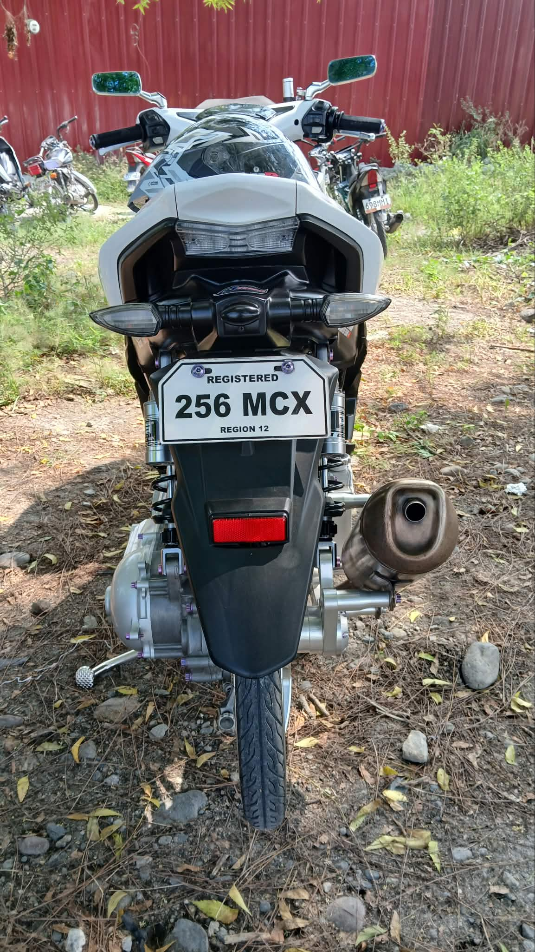
MOTORCYCLES RECOVERY
 | Date / Time of Operation | October 15, 2026
 | Place of Operation | NHW Labangal, General Santos City
 | Mode of Operation | AnCar, RA 4136 and Other related laws
 | Recovering unit | General Santos City HPT
 | Make/Type/Model | Yamaha
 | Plate Number | 256MCX
 | Chassis Number | PA0SG4910H0016529
 | Motor Number | G3J1E-0113703
 | Color | WHITE
 | Violation/s | Expired OR/CR "ATTA"
 | Status | Impounded for verification
 | Driver/possessor | Mansilla, John Mark P.
 | Address | Dadiangas North, General Santos City
 | Registered Owner | Magsico, Anna Marie C.
 | Address | Apopong, General Santos City
 | Action Taken | Inform rightful owner to bring updated registration.

Slide 16
ATTACHMENTS OF ENFORCEMENT OF TRAFFIC LAWS
ENFORCEMENT OF TRAFFIC LAWS
PHPT | ISSUANCES
 | TOPs | OVRs | TCTs | TOTAL
North Cotabato
Sultan Kudarat
South Cotabato
General Santos City | 15
Sarangani
HQs/SOT
TOTAL

Slide 17
CASE FILED IN COURT INVOLVED IN CARNAPPING
PHPT | TOTAL
North Cotabato
Sultan Kudarat
South Cotabato
General Santos City
Sarangani
Total

Slide 18
DHPG PROGRAM THRUST
RECAPITULATION OF DPHG PROGRAM THRUST17
PHPT | PD96 | ART. 177/ RA 3185/EO297/PD 38,ART179 |  | CONFISCATION/ REMOVAL (HPG Seal/Logo/Rider Badges
 |  |  |  | MV | MC | TOTAL
North Cotabato
Sultan Kudarat
South Cotabato
General Santos City
Sarangani
HQs/SOT
Total

Slide 19

END OF PRESENTATION
Notes:
That ends my presentation. Thank you and God Bless us all!

